Slide 1

University Canteen System
Database Programming

Slide 2
Participants of The Project
01.
03.
Bandula Dissanayaka
Diyanada J Gunawardena
02.
M. Dharshani
06.
04.
J. B. Jayawickrama
05.
Sarath Kumara
S. Sampaya
07.
M. S. N. Perara
Database Programming Project
1st Year – II Semester
B. Tech - Software Technology
B. Tech – Multimedia and Web Technology
2014-17 Batch
University of Vocational Technology

Slide 3
Let's Launch the System

Slide 4
Why We Created this Software
Reduce the queue of the canteen
Save the time of students when they use the canteen.
Young people are hate to use the real money.
Students are not getting the balance for the canteen.
The obstacles when communicating students who belong to different ethnic groups.
In order to implement the Technology in this technological University.
In order to Fulfill the requirements of the subject

Slide 5
Decisions for the mentioned issues
Electronic Cash System.
System for inventory of canteen
Introduce e-shop system
Centralized database.

Slide 6
Introduction for UCS
This software is developed for Our University canteen to deliver or take away foods and to use e-cash.
we developed that software for this project within very limited scope and limited time period of time.
And this software allow user to insert category wise foods/meals and
allow to add to invoice billing and printing .
Generate reports from the system.

Slide 7
Main Features
Allow Authorized people to supply food.
Allow to Add , Edit, Delete category wise.
Allow to Add, Edit, Delete Beverages.
Allow to issue meals to the customers
Allow to search category wise meals details.
Allow to create Reports.
Perfect bill printing system.
Allow to discard foods from the system.

Slide 8
Simple Structure of Our Software
Proximity Reader
Arduino
System (C# Program)
Database

Slide 9
Project time frame
Date | Requirement gathering | System Design | Implementation | Testing | Development of Presentation | Presenting the Project
13/02/2015
14/02/2015
15/02/2015
16/02/2015
17/02/2015
18/02/2015
19/02/2015
20/02/2015
21/02/2015
22/02/2015
23/02/2015
24/02/2015
25/02/2015
26/02/2015
27/02/2015
28/02/2015
01/3/2015
02/3/2015

Slide 10
Simple Structure of a Project - UCS
Hardware
Programs
Database
UCS - Main System
Required Two Hardware Components
UCS – Starter System
Centralized Database
Can Handle Many Systems
UCS – Installer System

Slide 11
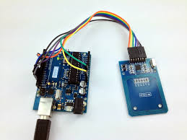
Hardware

Slide 12
Hardware Components of a Project - UCS
Proximity Reader (Rfid)
arduino
Read and Encrypt Identification of Proximity Card
Reed Identification of Proximity Card
Communicate With the Program (UCS Main)

Slide 13
Summery
All Input in Proximity Reader Must Include with Wiegand 26/36 Categories.
In this case we use C++ language and arduino programming language.
C++ language for make header file to reed value from proximity reader to arduino.
arduino programming language for program a IC (Integrated circuit) .
In this case we use AT328 IC (Integrated circuit) .

Slide 14
Barriers we Face
How to Find What is The Wiegand Category
  Our proximity reader allows to read proximity card between Wiegand 26 to Wiegand 36. But we do not have a way to find what is the Wiegand category that proximity card use in programmatically.
  We can easily solve this problem using only one category of Wiegand. But that is not practical because the proximity card manufacture has been using many categories of Wiegand. After a long search (internet and Books) we found source in Github. And we recoded that source in C++ language and attach as header file to arduino.
  Github Source - Source

Slide 15
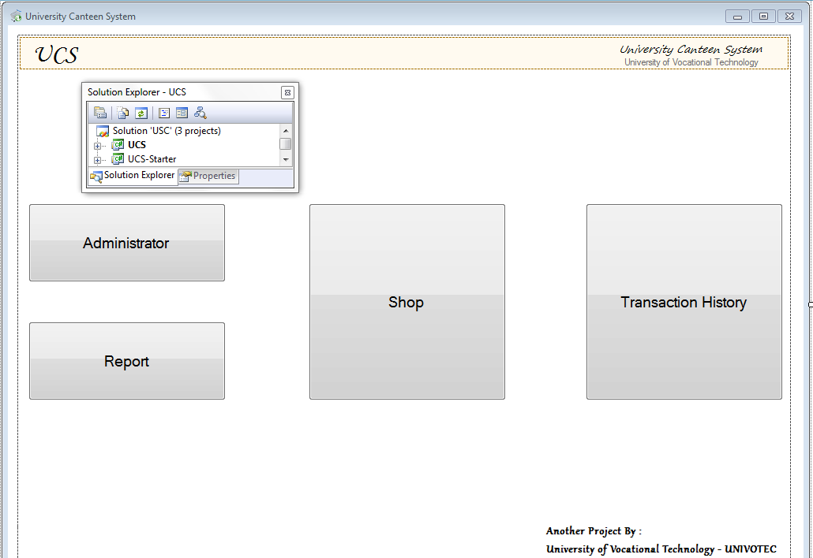
Programs

Slide 16
Program Components of a Project - UCS
UCS - Main
UCS – Starter
Kernel Program of The System
UCS – Setup
Making Database Configuration for UCS – Main (main Program)
This Project Make a Installable File with Installing Wizard for above Programs

Slide 17
UCS – Main Program
UCS – Main (Form1) Main Form
Administrator (For_Admin)
Report (Reporting)
Shop (Form2)
Transaction History (Form3)
System Settings (Tab 1)
Items Adding (Tab 2)
Item Quantity (Tab 3)
User Adding (Tab 4)
Quantity Discard (Tab 5)
Quantity Discarder (Discard)
Login (Login)
Login (Login)
Shop Items(Shop_Items)
Proximity Validation (Proximity)
Invoice (Invoice)
Print()
Login (Login)
Proximity Validation (Proximity)
Invoice (Invoice)
Print()
Print()
Credits (form4)
Proximity Validation (Proximity)

Slide 18
Summery
Develop Using C# language.
Included 11 (eleven) forms. (admin form include 6 tab index)
3 (three) Class file also in this solution.
And also one configuration file, language (xml), data source (.xsd) included in this solution.
No dependency in this solution.
.Net framework 3.5 is build framework of this program
Transaction Class file may include how to exchange credit (using database transaction / C# transaction)

Slide 19
Barriers we Face
Every member of our group haven’t been using C# language to even to create a Hello world programme.
We are unable to set a textbox for Price item, quantity ,users ,credit ,because the user can insert any character ,so we need a numeric textbox.
According to the Database We should add Dynamic programmatically buttons
There should be a click event for each particular button & We should add Dynamic numeric up down in order to access
We had to suffer to find out How to communicate using serial port
We had to suffer to find out How to make form with return value, How return value form database function, store procedures to c# program
We came to know How to print using c# program after a serious study.

Slide 20
UCS – Starter Program
Starter Program
Make Connection with Database
Update Configuration Files
Section of data folder
Selection of COM Ports

Slide 21
Summery
Develop Using C# language.
Included 1 form.
No dependency in this solution.
.Net framework 2.0 is build framework of this program
Default this program run inside the ucs setup.
The main task of this programme is to connect the Database.
And also we searched the way to find details about serial port & data folder.
We could be able to edit the changes that are happening to the system When the system installed again, (Changes of Database, change data folder& etc.)with the help of this programme accurately.

Slide 22
UCS – Setup Program
Setup Program
Installation
Uninstallation
Run UCS – Starter exe
Repair

Slide 23
Summery
Develop Using Visual basic language.
Setup wizard type Solution
3 (three) Class file also in this solution.
Main duties Install, Uninstall, Repair and Run UCS Starter project.
dependent of this solution with Others(UCS main & UCS Starter).
.Net framework 3.5 is build framework of this program
Size of the .msi file is 3.9 MB
Required administrator privileges to run.

Slide 24
Barriers we Face
No any Visual Basic Language experts in our group.
How to run a C# program inside the VB setup solution.

Slide 25

Database

Slide 26
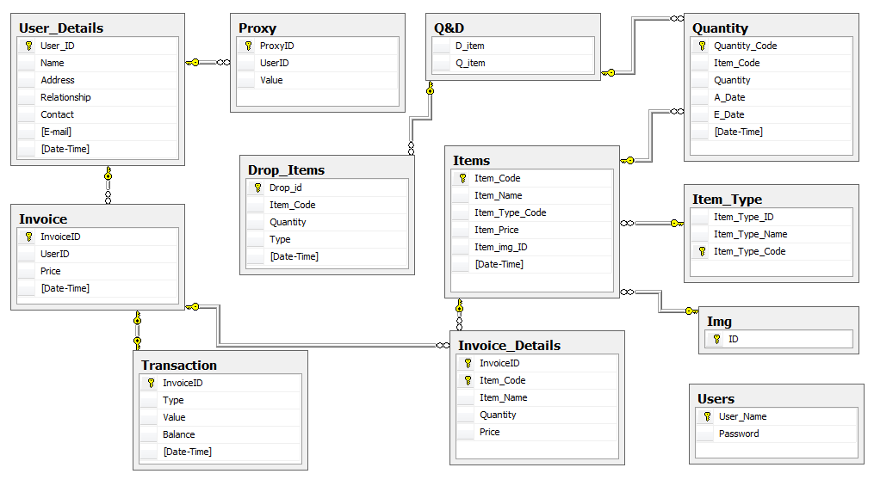
Database Diagram

Slide 27
Database Column

Slide 28
Database Views
Include 6 views
  Shop
  New Items
  New Quantity
  Discard_view
  View_User
  Invoice_Transaction
We use views when we load data to the data drive of the C# programe and reduce complexity of data .

Slide 29
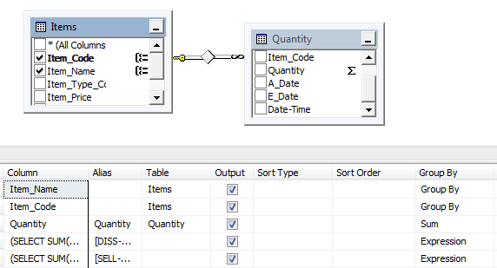
Example :
SELECT dbo.Items.Item_Name, dbo.Items.Item_Code, SUM(dbo.Quantity.Quantity) AS Quantity, (SELECT SUM(Quantity) AS Expr1 FROM dbo.Drop_Items WHERE (Item_Code = dbo.Items.Item_Code) AND (Type = 'DISS')) AS [DISS-Quantity], (SELECT SUM(Quantity) AS Expr1 FROM dbo.Drop_Items AS Drop_Items_1 WHERE (Item_Code = dbo.Items.Item_Code) AND (Type = 'SELL')) AS [SELL-Quantity]
FROM dbo.Items INNER JOIN dbo.Quantity ON dbo.Items.Item_Code = dbo.Quantity.Item_Code
GROUP BY dbo.Items.Item_Code, dbo.Items.Item_Name

Slide 30
Database Stored Procedures
Include 11 stored procedures in our database
  Quantitys
  Item
  Delete_Quantity
  Cash_Deposit
  Update_Value
  Add_user
  Get_transaction
  Make_InviceID
  Add_Invoice_Details
  DPSell_Item
  DPDiss_Item
We use store procedure when inserting data to the Database .

Slide 31
CREATE PROCEDURE [dbo].[Cash_Deposit]
@userid nvarchar(16),
@price float
AS
BEGIN
DECLARE @result varchar(20)
DECLARE @cot varchar(10)
DECLARE @val float
BEGIN TRANSACTION;
BEGIN TRY
SET @cot = (select count(*) from Invoice) + 1;
SET @result = ('UCS-INVO-DP-') + CONVERT(nvarchar(10), @cot);
insert into Invoice(InvoiceID, UserID, Price, [Date-Time])
values(@result, @userid, @price, GETDATE());
insert into Invoice_Details(InvoiceID, Item_Code, Item_Name, Quantity, Price)
values(@result, 'DEPOSIT', 'DEPOSIT', 1, @price)
select @val = Value from Proxy where UserID = @userid
UPDATE Proxy SET Value =(@val+@price) where UserID = @userid
insert into [Transaction](InvoiceID, [Type], Value, Balance, [Date-Time])
values(@result, 'ADD',@price , (@val+@price), GETDATE())
END TRY
BEGIN CATCH
SELECT ERROR_NUMBER() AS ErrorNumber ,ERROR_SEVERITY() AS ErrorSeverity ,ERROR_STATE() AS ErrorState ,ERROR_PROCEDURE() AS ErrorProcedure ,ERROR_LINE() AS ErrorLine ,ERROR_MESSAGE() AS ErrorMessage;
IF @@TRANCOUNT > 0ROLLBACK TRANSACTION;
END CATCH;
IF @@TRANCOUNT > 0
COMMIT TRANSACTION;
Example :

Slide 32
Database Function
Include 2 scalar value function and 4 table value function.
Scalar value function
  Img_select
  Password
Table value function
  Inovice_Details
  Drop_Item_View
  SHOP_NON_PARA
  NEW_SHOP

Slide 33
Example :
Table value function
ALTER FUNCTION [dbo].[NEW_SHOP] (
@var1 nvarchar(30)
)
RETURNS TABLE
AS
RETURN
(
SELECT dbo.Quantity.Item_Code AS [Item Code], dbo.Items.Item_Name AS [Item Name], dbo.Item_Type.Item_Type_Name AS [Item Type],
(SUM(dbo.Quantity.Quantity)) - (SELECT SUM(Quantity)FROM dbo.Drop_Items WHERE (Item_Code = dbo.Quantity.Item_Code)) AS Quantity, dbo.Items.Item_Price AS Price, dbo.Items.Item_img_ID AS Image, dbo.Item_Type.Item_Type_Code AS [Type ID]
FROM dbo.Quantity INNER JOIN dbo.Items ON dbo.Quantity.Item_Code = dbo.Items.Item_Code INNER JOIN dbo.Item_Type ON dbo.Items.Item_Type_Code = dbo.Item_Type.Item_Type_Code
GROUP BY dbo.Quantity.Item_Code, dbo.Items.Item_Name, dbo.Items.Item_Price, dbo.Item_Type.Item_Type_Name, dbo.Items.Item_img_ID, dbo.Item_Type.Item_Type_Code
)

Slide 34
Example :
Scalar value function
USE [UCS]
GO
SET ANSI_NULLS ON
GO
SET QUOTED_IDENTIFIER ON
GO
ALTER function [dbo].[Password](
@username nvarchar(20)
)
returns nvarchar(300)
AS
BRGIN
declare @result nvarchar(300)
select @result=Password from Users where [User_Name] = @username
return @result
END

Slide 35
Database Triggers
Include only one trigger in in this database
  Q&D_Trigger
Example :
CREATE TRIGGER [dbo].[Q&D_Trigger] ON [dbo].[Drop_Items]
FOR INSERT
AS
BEGIN
declare @ditem varchar(50);
declare @qitem varchar(50);
select @ditem=i.Drop_ID from inserted i;
select @qitem=i.Item_Code from inserted i;
insert into [Q&D](D_item,Q_item)
values(@ditem,@qitem);
END

Slide 36
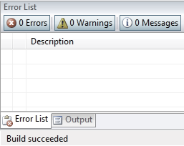
Finally

Slide 37
Presentation
OVER!
Thank You

